Slide 1
Computer Vision 23/24
By Galizia Stefano matr. 1883239 and Mario Formato matr. 2152143

Slide 2
Anomaly Detection
Our task is to find and classify the anomalous images present in the dataset: AeBAD-S dataset (Aero-engine Blade Anomaly Detection Dataset), which consists of images depicting parts of aircraft wings or blades.

Slide 3
Dataset Structure
Number of images used to train the detectors: 520
The train set has been split in: 80% for training and 20% for validation
Number of images used to test the detectors: 895
Number of images used to train the classifiers: 744
Number of images used to test the classifiers: 405
Original dimension of images: 3024x3024

Slide 4
Train set
The train set is composed by one folder that contains all good images to train the model.
The folder contains images for which a specific characteristic is altered: Background, Illumination and view.
Background, view and Illumination in the training set are different from the ones in the test set, in fact, they have never been seen during training

Slide 5
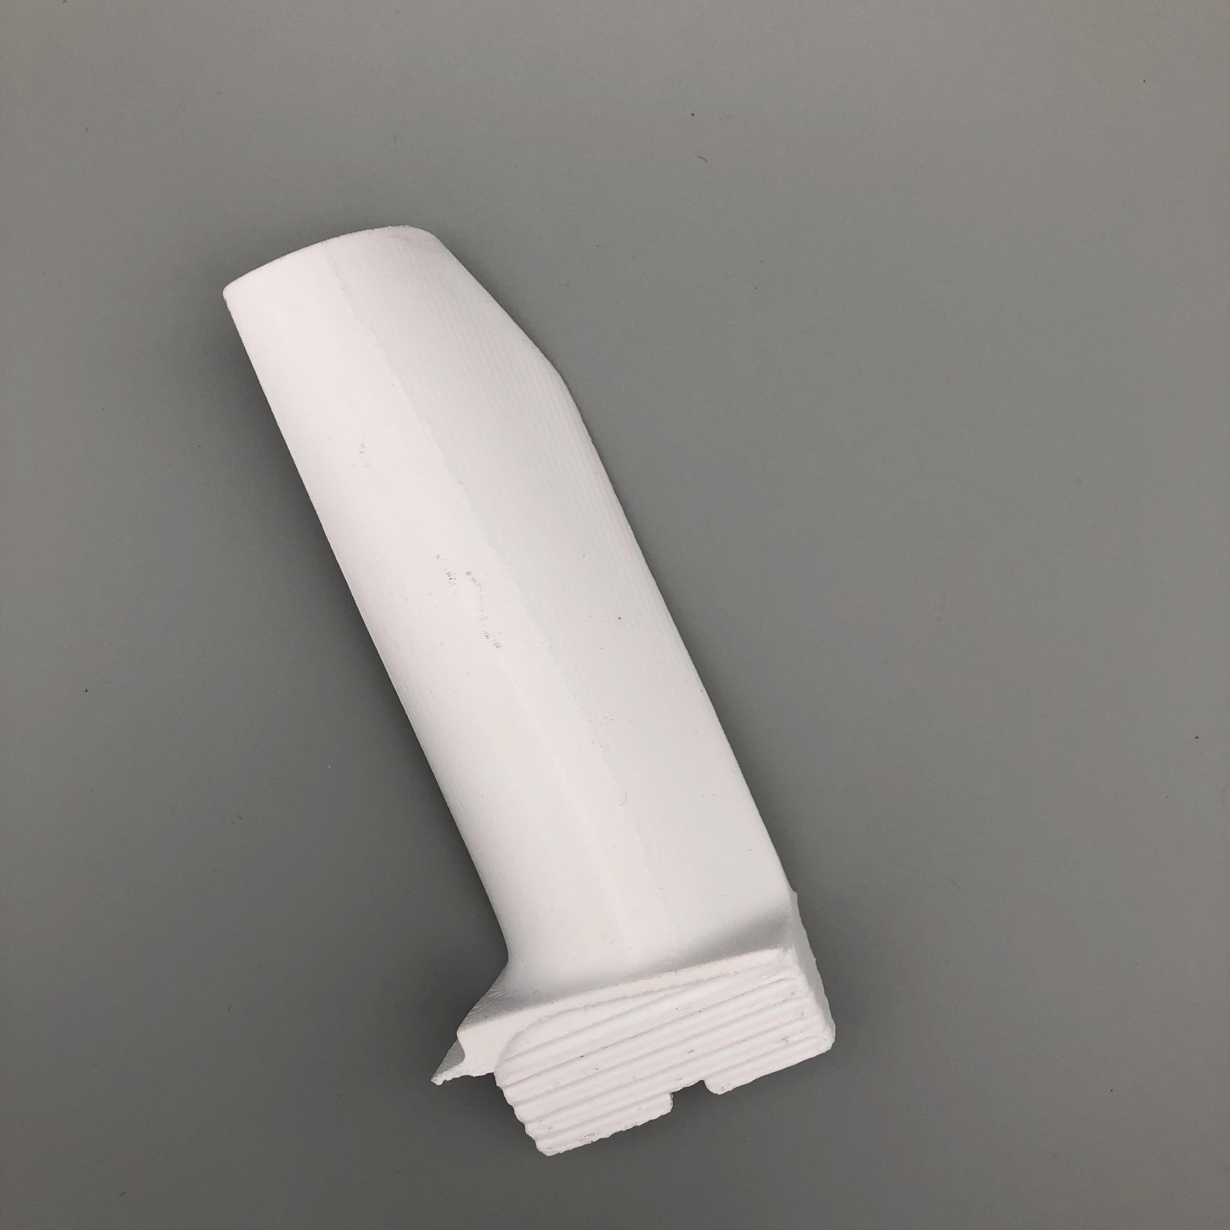
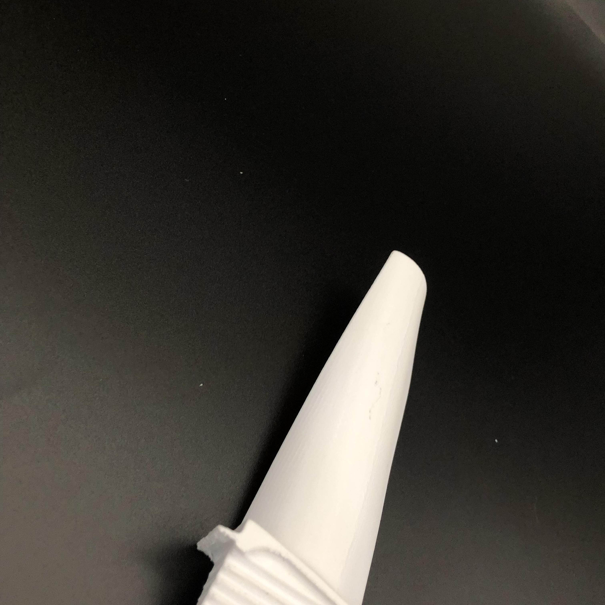
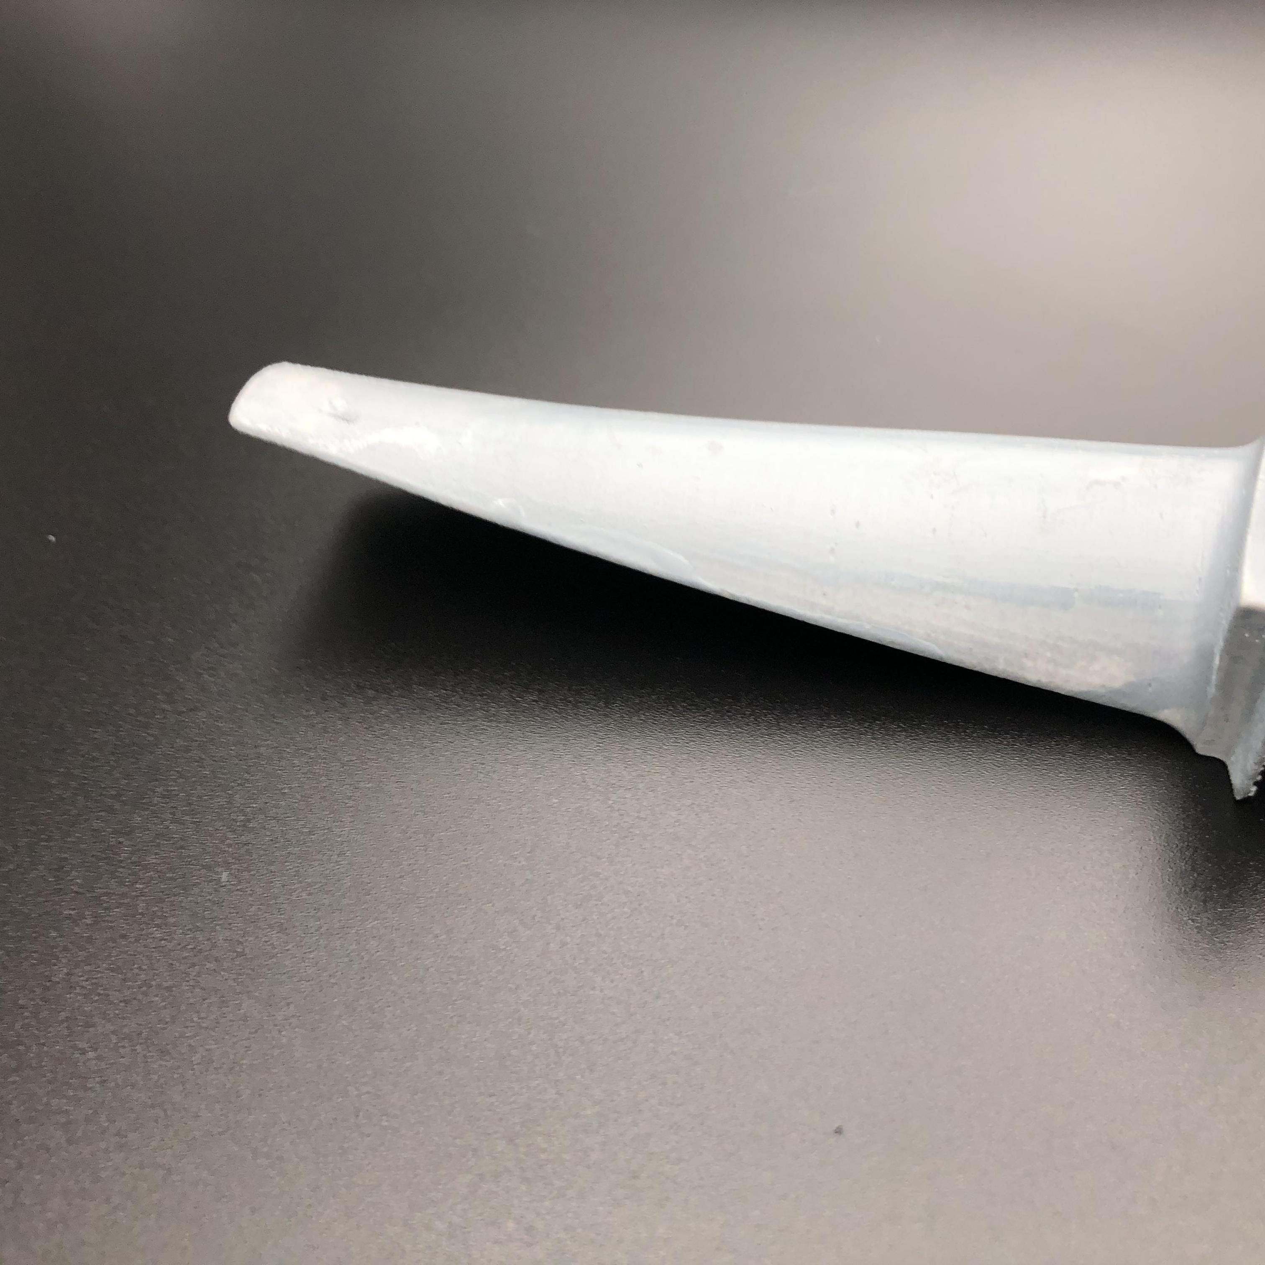
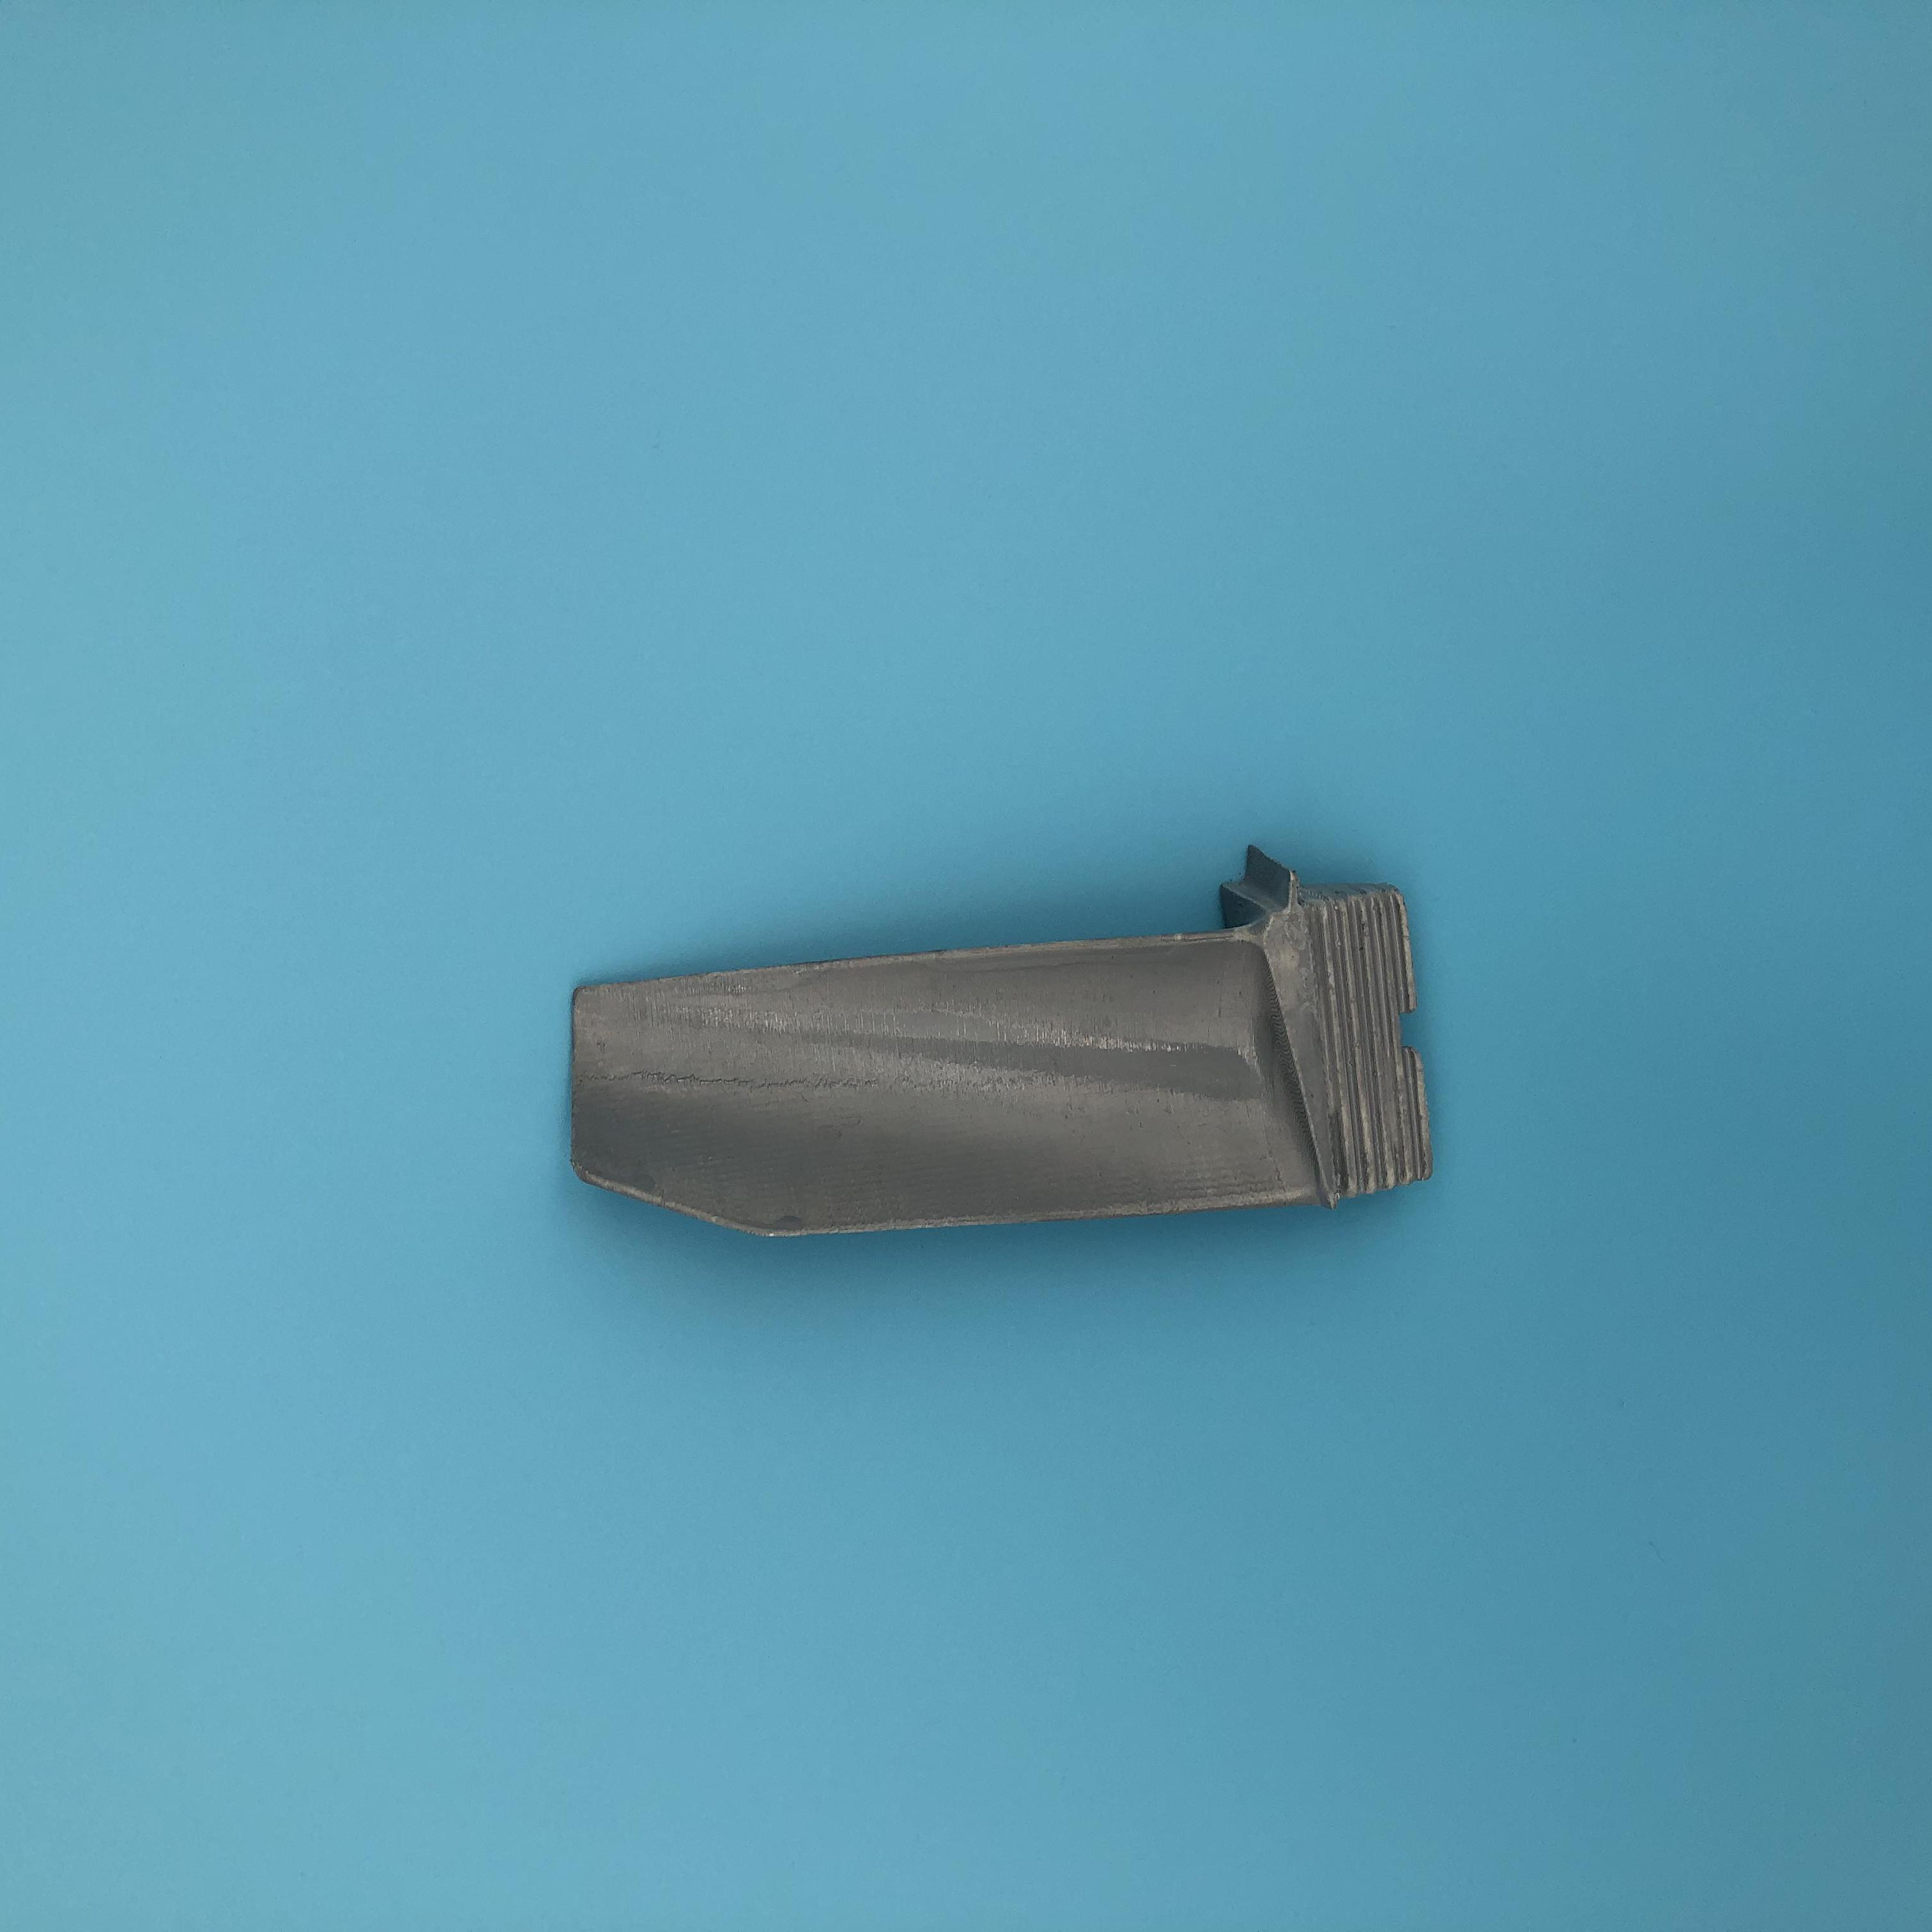
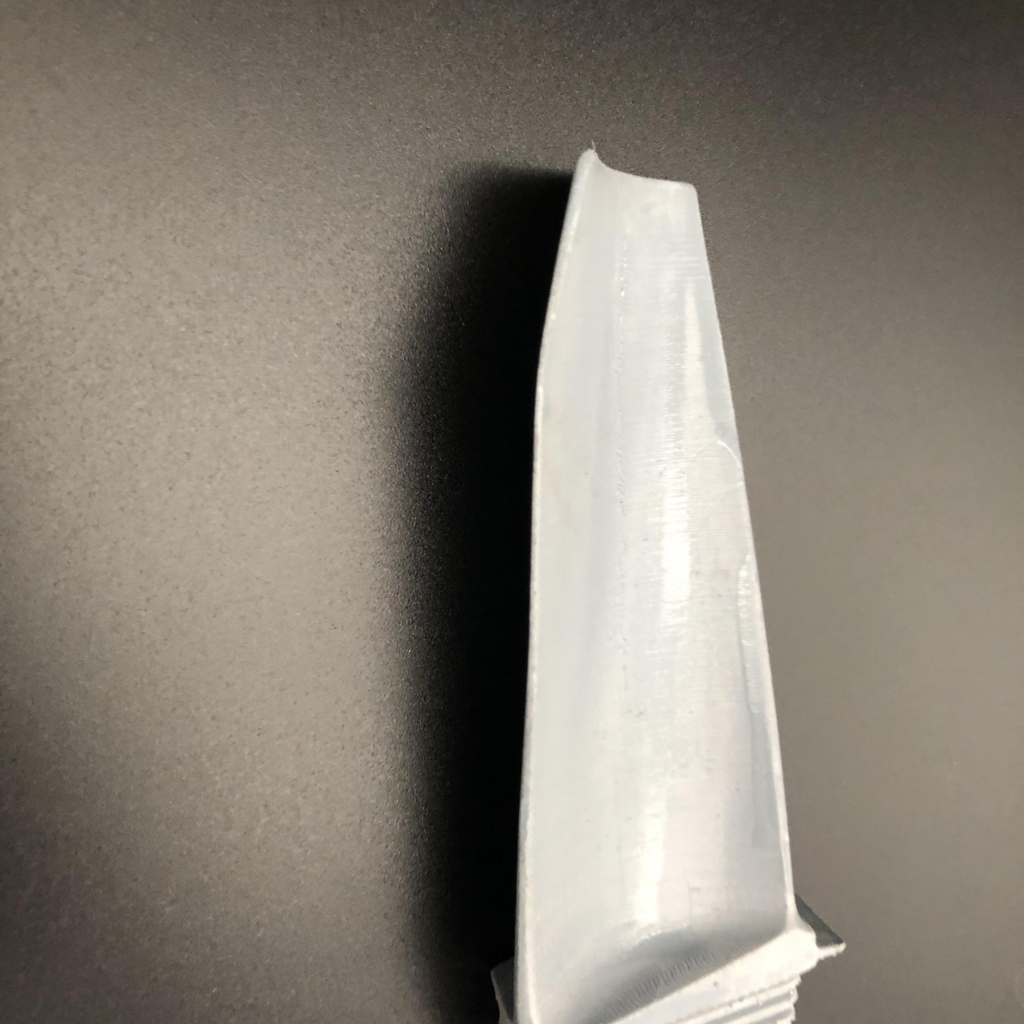
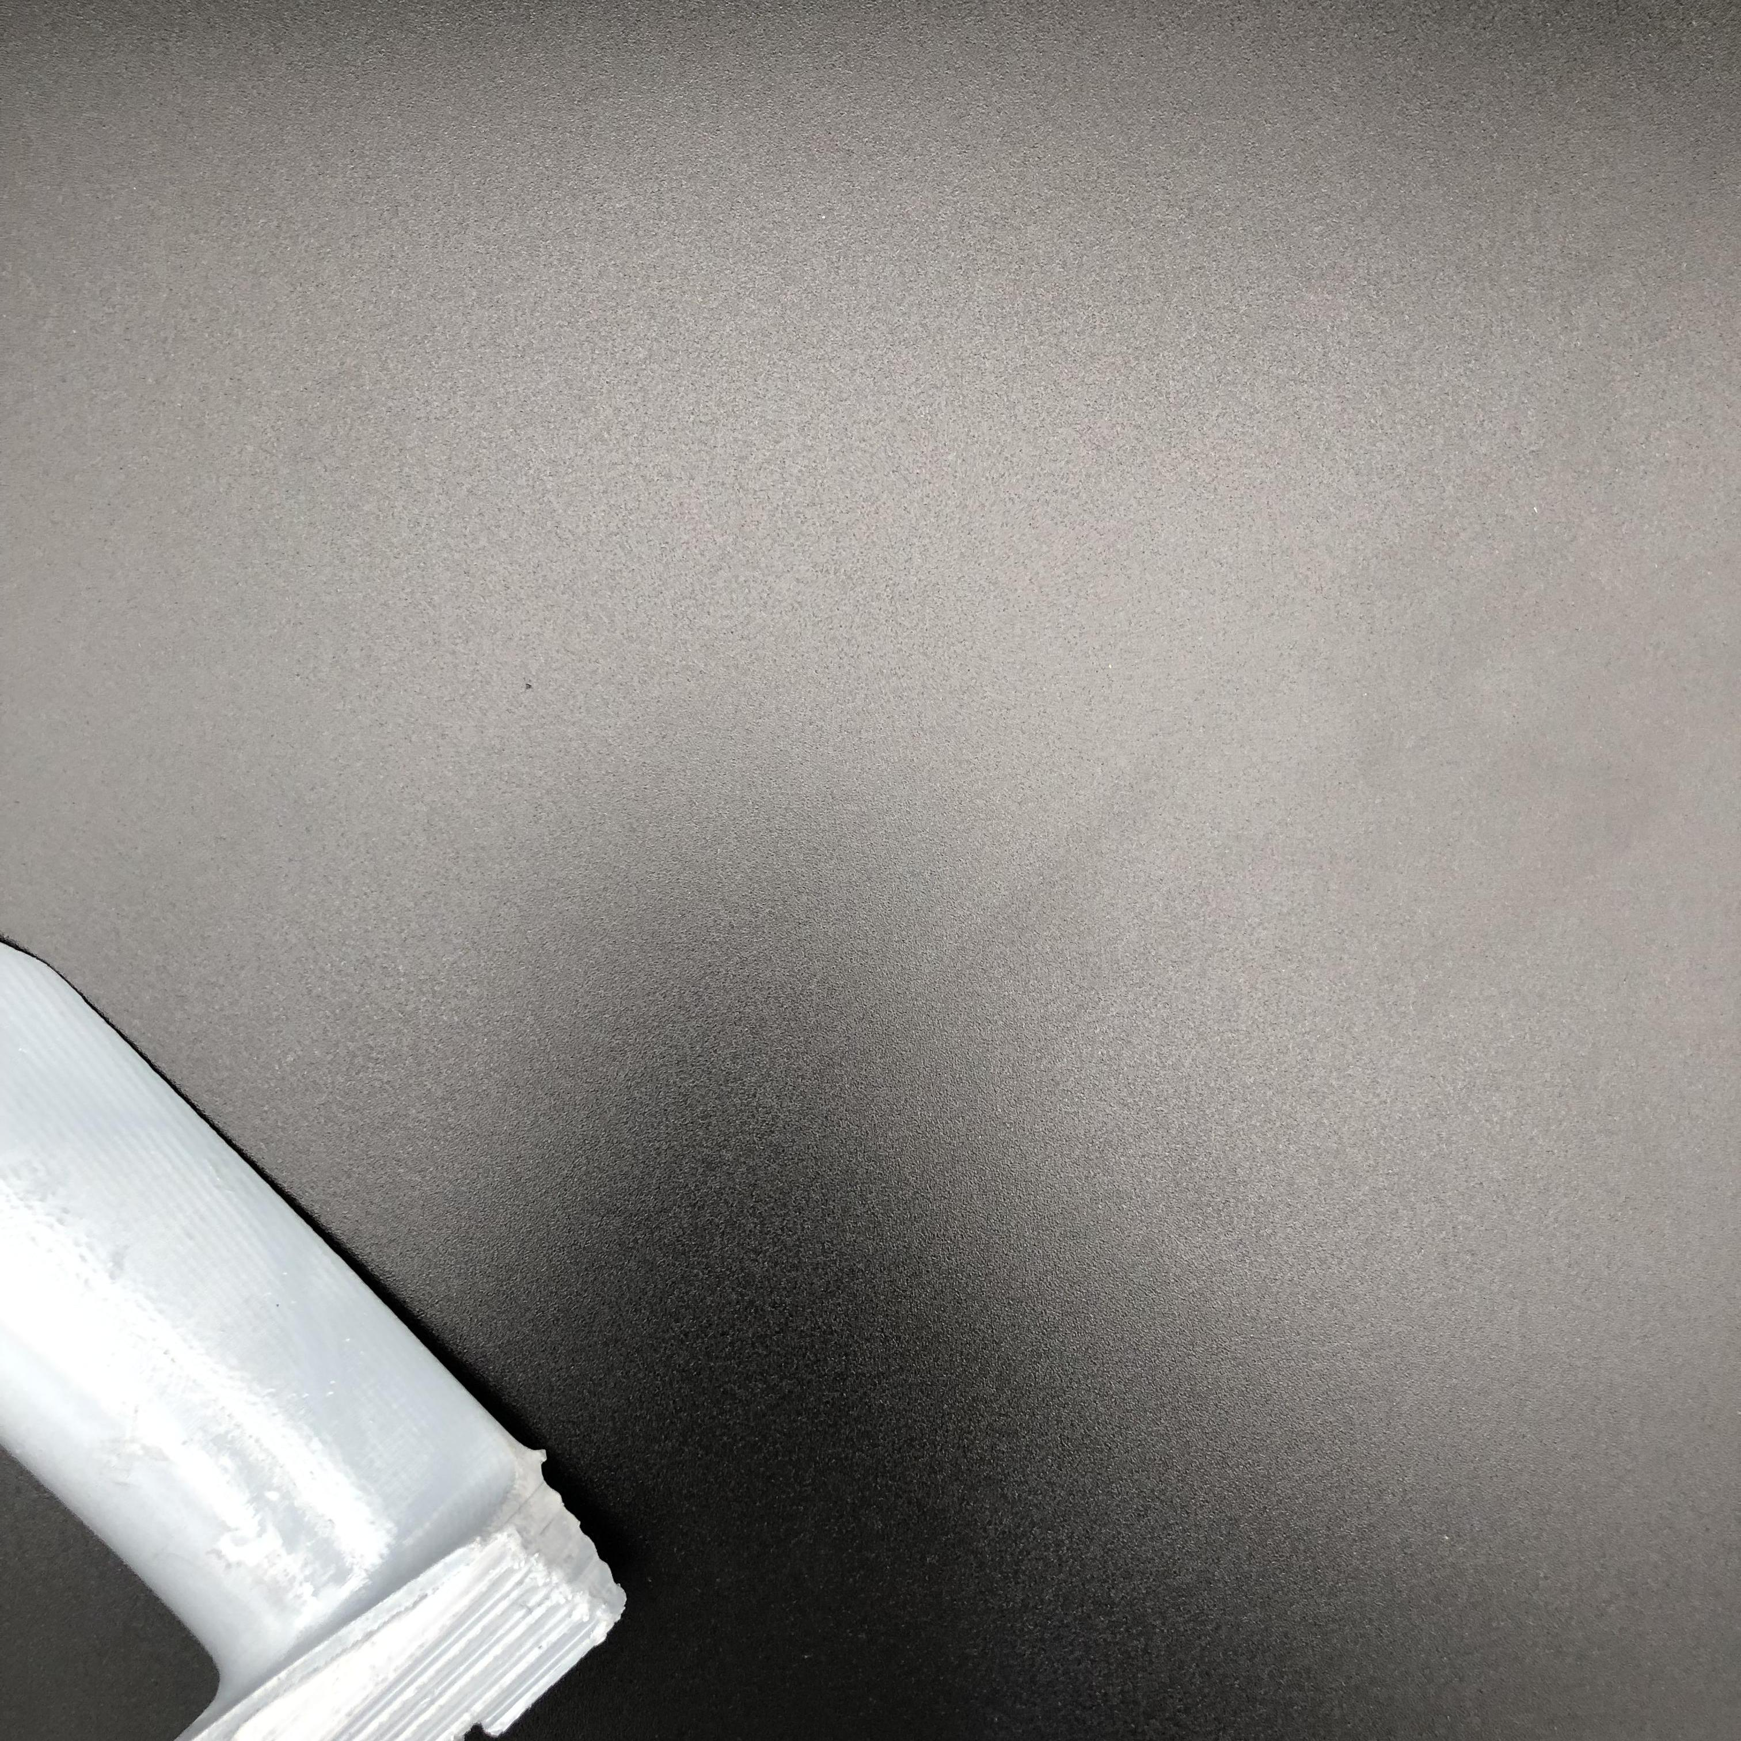
Examples of images in train set
Background
Illumination
View

Slide 6
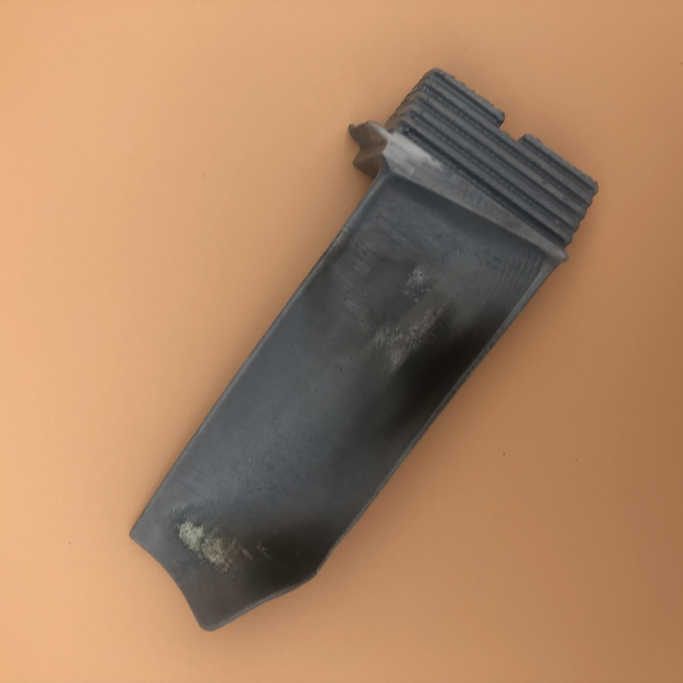
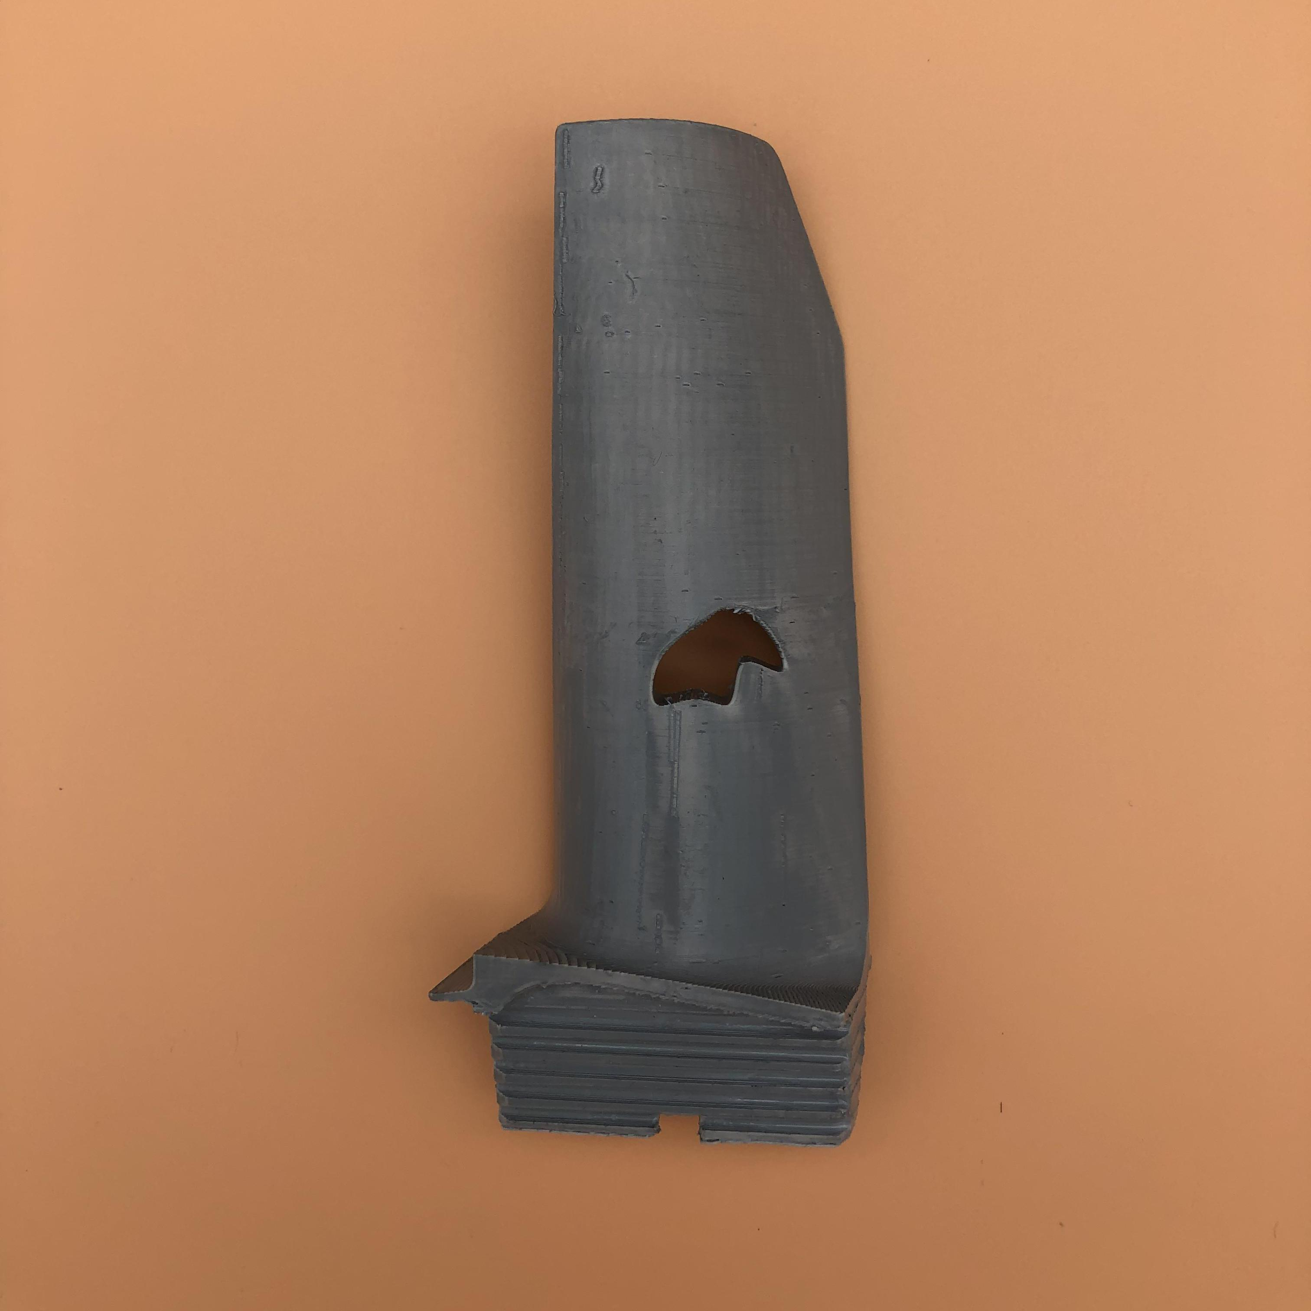
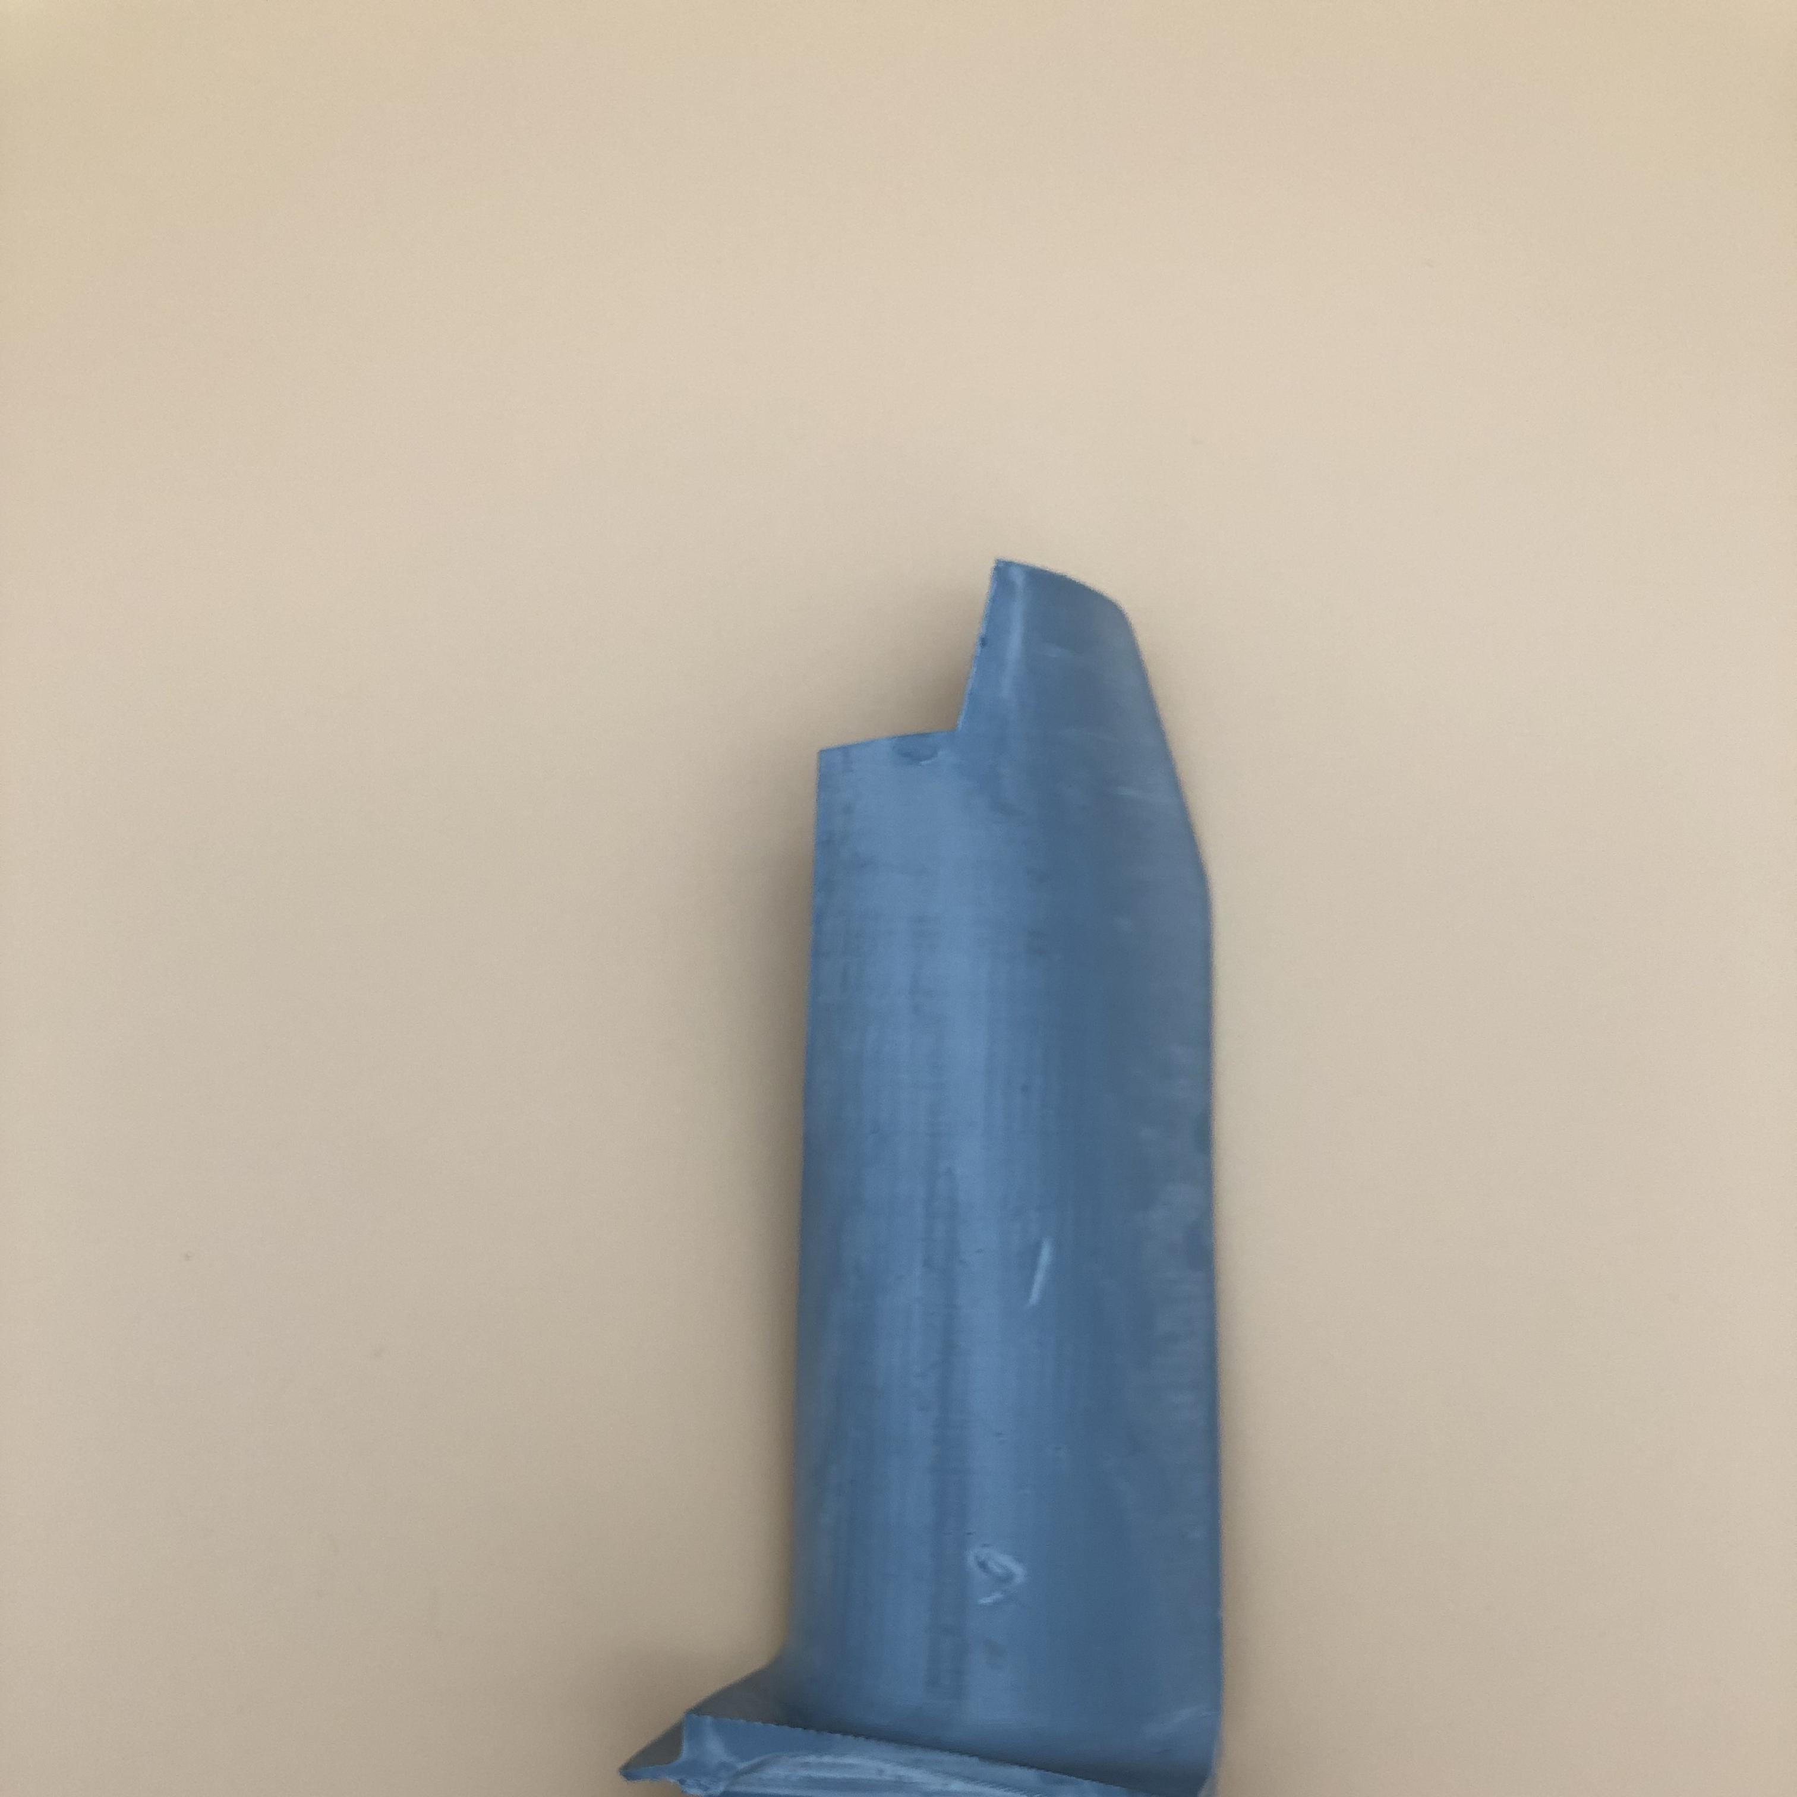
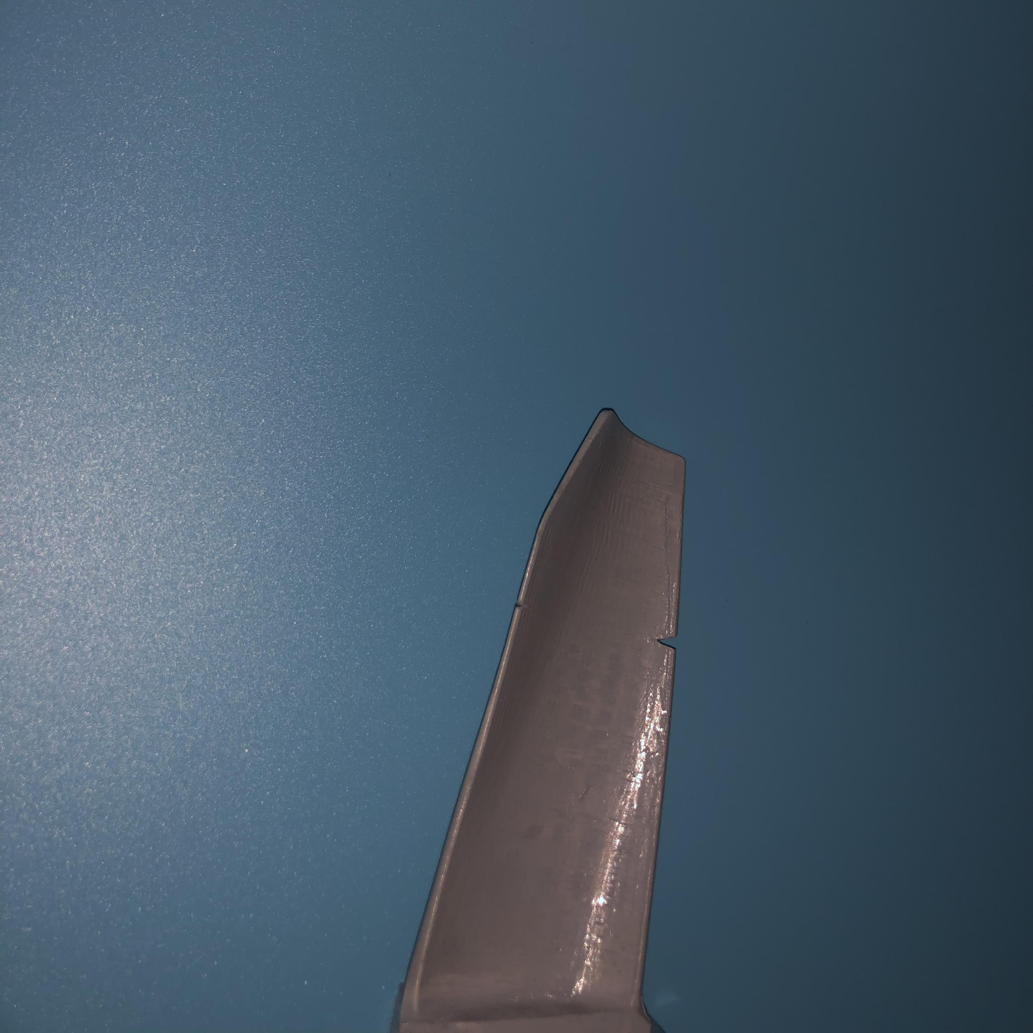
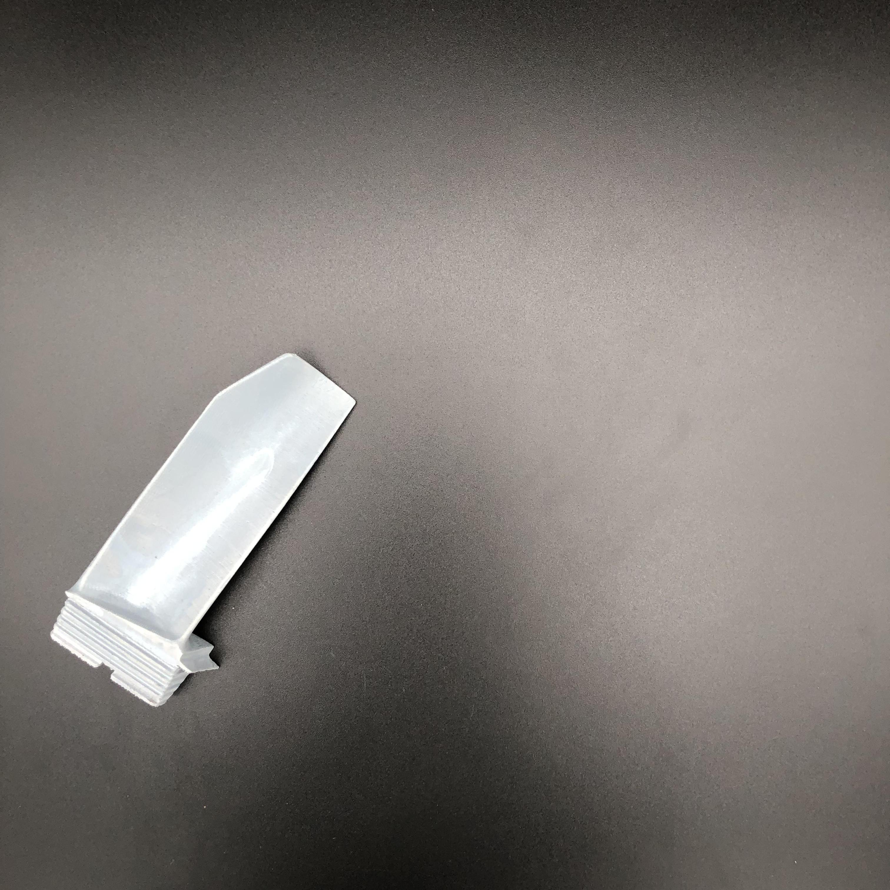
Test set
The test set is divided into folders that indicate the type of damage in the images: ablation, breakdown, fracture, groove, and good.
Ablation
Breakdown
Fracture
Groove
Good

Slide 7
Data preprocessing
Bilateral Filter: It is a non-linear filter that smooths the image (reducing noise) while keeping the edges sharp.
Sharpen Filter: This operation enhances the details of an image by increasing the contrast of the pixels at the edges of objects, making the contours appear sharper.
Resize((224,224)): Resizes the image to a dimension of 224x224 pixels

Slide 8
Data Augmentation
RandomHorizontalFlip(p): Randomly performs a horizontal flip on the image with a probability of p.
RandomRotation(a): Rotates the image by a random angle between a and -a.
ColorJitter(brightness=p, contrast=p, saturation=p): Randomly modify the brightness, contrast, and saturation of the image, with variations up to p% from the original values

Slide 9
First method: Autoencoder
The autoencoder takes as input an image of size (3, 224, 224) and passes through a series of convolutions and transposed convolutions to compress and then reconstruct the image.
It is divided into an encoder and a decoder:
Encoder: compresses the image by progressively reducing the spatial dimensions (height and width) while increasing the number of channels.
Decoder: performs the inverse operation, progressively expanding the spatial dimensions until the image is restored to its original size.
The final output of the decoder is a reconstructed image with the same dimensions as the original input, but this time with pixel values compressed to a range of [0,1] due to the sigmoid() function.

Slide 10
Example of Autoencoder Structure
ENCODER
DECODER
(3,224,224)
(3,224,224)
(16,112,112)
(16,112,112)
(32,56,56)
(32,56,56)
(64,28,28)
(64,28,28)
(128,14,14)
(c, h, w) : c = number of channels, h = high e w = width

Slide 11
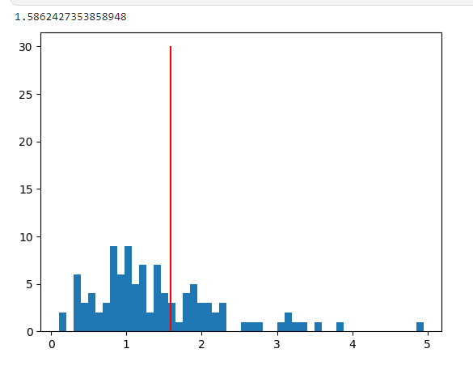
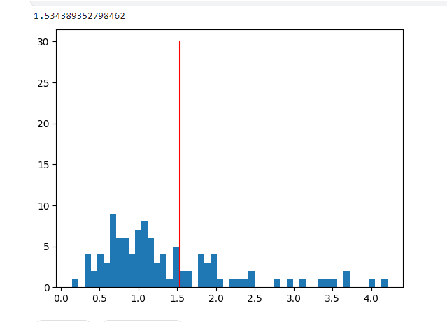
Threshold estimation
Threshold estimated using the original image and its reconstruction: MSE (mean square error), where we square the difference between the original and the reconstruction and add this value to the list. I do this for each image in the val_dataset. I obtain the threshold as follows:
Best_threshold = np.mean(list) + K*np.std(list)
Threshold estimated in 3_layer_model
Threshold estimated in 4_layer_model

Slide 12
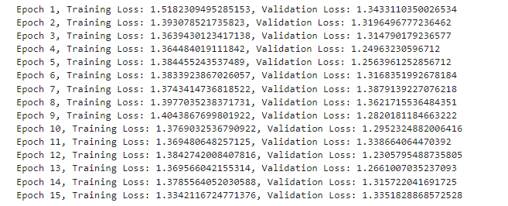
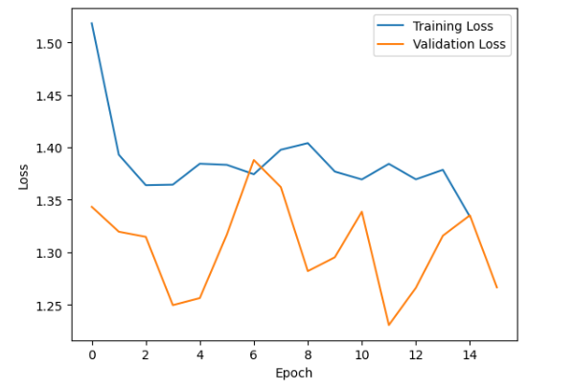
Training results 1st model

Slide 13
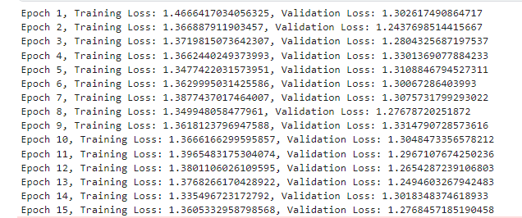
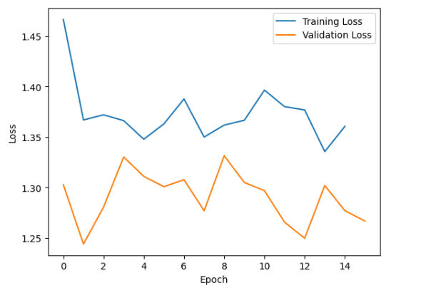
1st Model
Convolution - ReLU
k = 3 S = 2 P = 1
3x224x224 → 16x112x112
Convolution - ReLU
k = 3 S = 2 P = 1
16x112x112 → 32x56x55
Convolution - ReLU
k = 3 S = 2 P = 1
32x56x56 → 64x28x28
Transposed Conv - ReLU
k = 3 S = 2 P=1 OP = 1
64x28x23 → 32x56x56
Transposed Conv - ReLU
k = 3 S = 2 P=1 OP = 1
32x56x56 → 16x112x112
TransposedConv-Sigmoid
k = 3 S = 2 P=1 OP = 1
16x112x112 → 3x224x224

Slide 14
2nd Model
Convolution - ReLU
k = 3 S = 2 P = 1
3x224x224 → 16x112x112
Dropout(0.2)
Convolution - ReLU
k = 3 S = 2 P = 1
16x112x112 → 32x56x55
Dropout(0.2)
Convolution - ReLU
k = 3 S = 2 P = 1
32x56x56 → 64x28x28
Dropout(0.2)
Transposed Conv - ReLU
k = 3 S = 2 P=1 OP = 1
64x28x23 → 32x56x56
Dropout(0.2)
Transposed Conv -ReLU
k = 3 S = 2 P=1 OP = 1
32x56x56 → 16x112x112
Dropout(0.2)
TransposedConv-Sigmoid
k = 3 S = 2 P=1 OP = 1
16x112x112 → 3x224x224

Slide 15
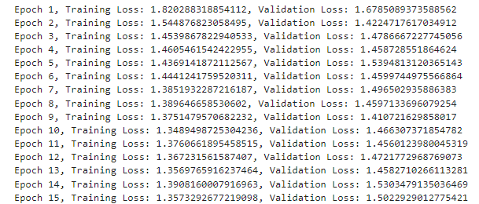
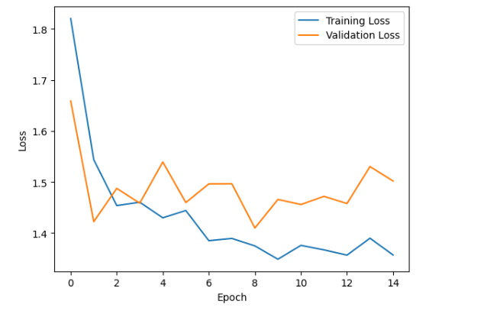
3rd Model
Convolution - ReLU
k = 3 S = 2 P = 1
3x224x224 → 16x112x112
Dropout(0.2)
Convolution - ReLU
k = 3 S = 2 P = 1
16x112x112 → 32x56x55
Dropout(0.2)
Convolution - ReLU
k = 3 S = 2 P = 1
32x56x56 → 64x28x28
Dropout(0.2)
Convolution - ReLU
k = 3 S = 2 P = 1
64x28x28→ 128x14x14
Dropout(0.2)
Transposed Conv - ReLU
k = 3 S = 2 P=1 OP = 1
128x14x14 → 64x28x28
Dropout(0.2)
Transposed Conv - ReLU
k = 3 S = 2 P=1 OP = 1
64x28x28 → 32x56x56
Dropout(0.2)
Transposed Conv -ReLU
k = 3 S = 2 P=1 OP = 1
32x56x56 → 16x112x112
Dropout(0.2)
TransposedConv-Sigmoid
k = 3 S = 2 P=1 OP = 1
16x112x112 → 3x224x224

Slide 16
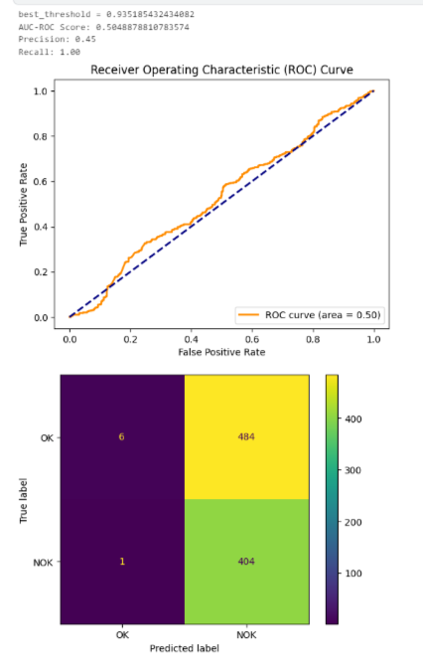
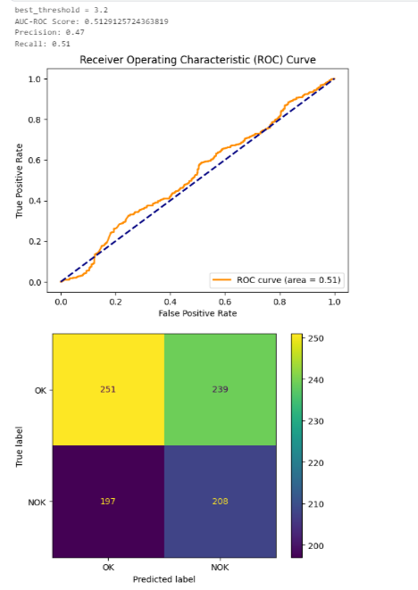
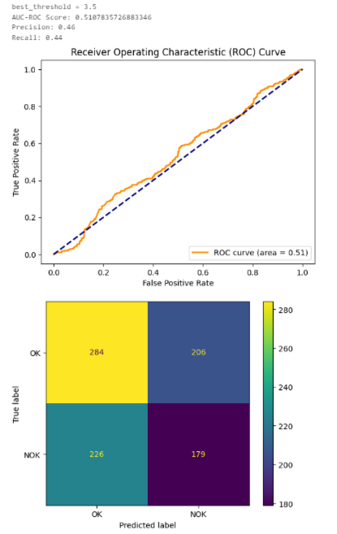
Testing results 1st Method

Slide 17
Second Method: auto-encoder with feature extraction using resnet
ResNet50: It is a convolutional neural network with 50 layers of depth.
We will use ResNet50 as a backbone, specifically for feature extraction at an intermediate level, using its deep convolutional layers.
We need to extract features from intermediate layers, requiring two outputs from the following layers: layer 2 (layer2.3.bn3.bias) and layer 3 (layer3.5.bn3.bias)
We are going to use a hook function, it adds the output of the two attached layers to the list: features.

Slide 18
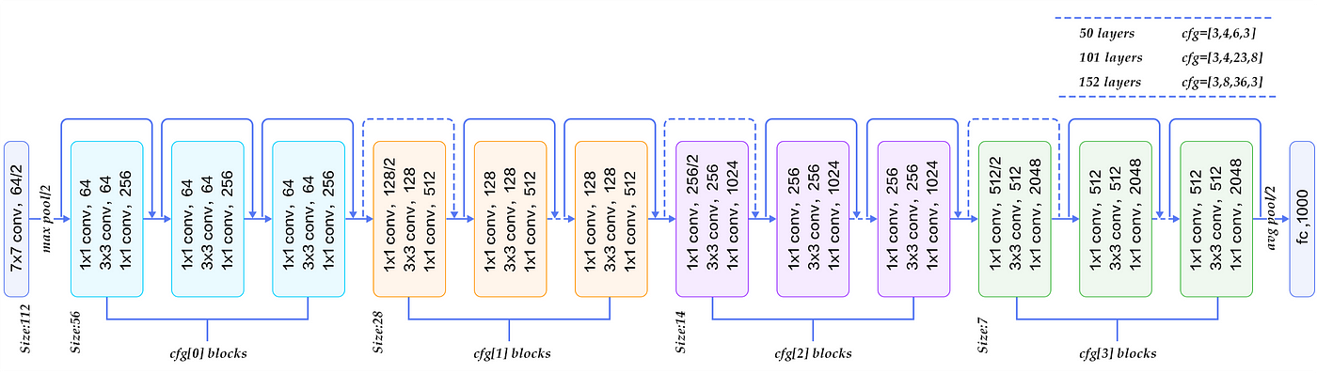
Structure of resnet50
(1024,14,14)
(512,28,28)

Slide 19
Second Method: auto-encoder with feature extraction using resnet
Finally, we will use an aggregation function to concatenate all the features into a single feature map that incorporates information from the outputs of the two ResNet layers.
The autoencoder will receive as input the feature map obtained from ResNet with the following dimensions: ([1, 1536, 28, 28]) = ([1, 512, 28, 28]) + ([1, 1024, 28, 28]).
(Aggregation function: concatenation of the outputs from the two ResNet layers. This is only possible if both outputs have the same dimensions, so we perform a resizing to ensure a common dimension: ([1, 1024, 14, 14])-> ([1, 1024, 28, 28]) .)

Slide 20
Aggregation function
(512,28,28)
DIM EXTRACTED FEATURES FROM
2° LAYER
(1536,28,28)
DIM EXTRACTED FEATURES
FROM 3° LAYER
(1024,28,28)
(1024,14,14)
UPSCALE

Slide 21
Motivation
Why we have to do that?
The idea of reducing the number of channels while keeping the spatial dimensions of the feature maps unchanged is a compromise between reducing complexity and maintaining spatial information.
This allows us to preserve the localization of anomalies, focusing only on the most important features, which is crucial in the task of anomaly detection.
Further reducing the spatial dimensions could result in the loss of spatial details that are important for identifying anomalies.
Reducing the number of channels, for instance by compressing from 1536 to a smaller value, allows you to focus on the most relevant features and simplify the model.
The feature maps obtained from ResNet have spatial dimensions of 28x28, which represent a compact resolution, but it is rich of information compared to the original input.

Slide 22
Threshold estimation
For the estimation of the threshold, we also use MSE (mean square error), but this time we will find the difference between the features obtained from ResNet50 and those recreated by the autoencoder.
Once we calculate the difference between these values, we will obtain a segmentation map (list).
We compute the mean of the 10 highest values present in the segmentation map and add the obtained value to a list. (We use the sum of the top 10 values, because higher is the reconstruction loss and higher are the chances that it is an anomal image).
So we estrimate: best_threshold = np.mean(list) + k * np.std(list).
We are going to use this threshold to evaluate whether the elements are anomalous or not.

Slide 23
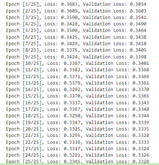
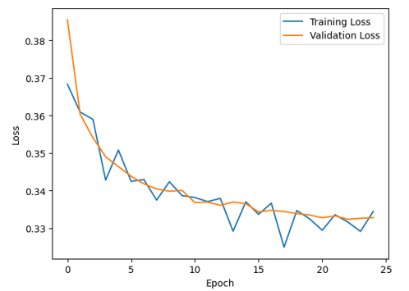
1st Model
Convolution
k = 1 S = 1
BatchNorm - ReLU
1536x28x28→ 868x28x28
Convolution
k = 1 S = 1
BatchNorm - ReLU
868x28x28→ 200x28x28
Convolution
k = 1 S = 1
200x28x28→ 100x28x28
Transposed Conv
BatchNorm- ReLU
k = 1 S = 1
100x28x28→ 200x28x28
Transposed Conv
BatchNorm- ReLU
k = 1 S = 1
200x28x28→ 868x28x28
TransposedConv
k = 1 S = 1
868x28x28→ 1536x28x28

Slide 24
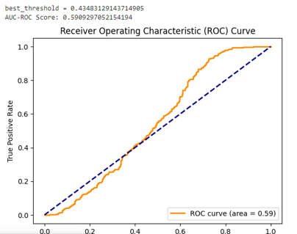
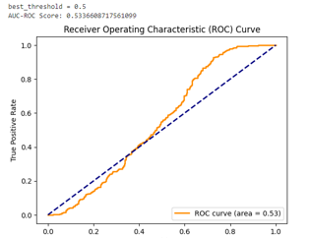
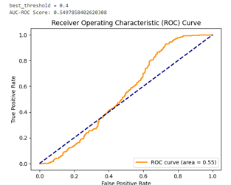
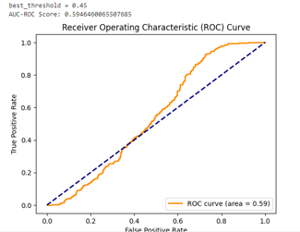
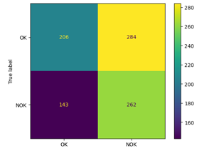
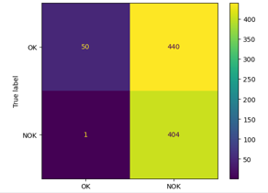
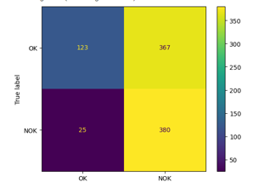
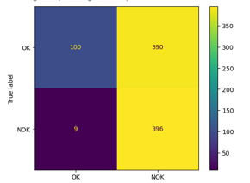
Testing results 1st model

Slide 25
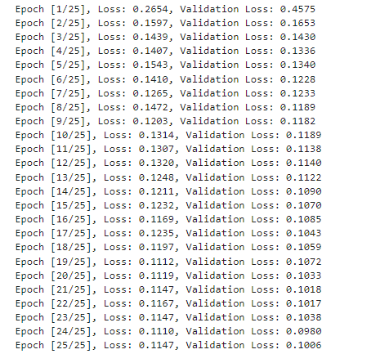
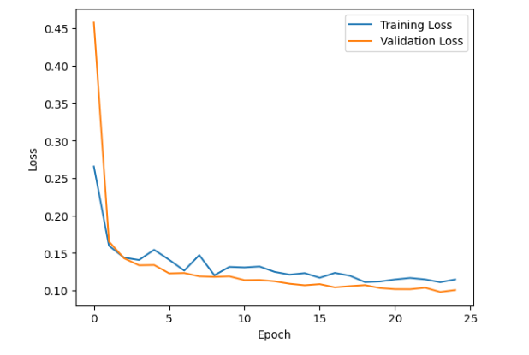
2nd Model
Convolution
k = 1 S = 1
BatchNorm - ReLU
1536x28x28→ 868x28x28
Dropout(0.3)
Convolution
k = 1 S = 1
BatchNorm - ReLU
868x28x28→ 200x28x28
Dropout(0.3)
Convolution
k = 1 S = 1
200x28x28→ 100x28x28
Transposed Conv
BatchNorm- ReLU
k = 1 S = 1
100x28x28→ 200x28x28
Dropout(0.3)
Transposed Conv
BatchNorm- ReLU
k = 1 S = 1
200x28x28→ 868x28x28
Dropout(0.3)
TransposedConv
k = 1 S = 1
868x28x28→ 1536x28x28

Slide 26
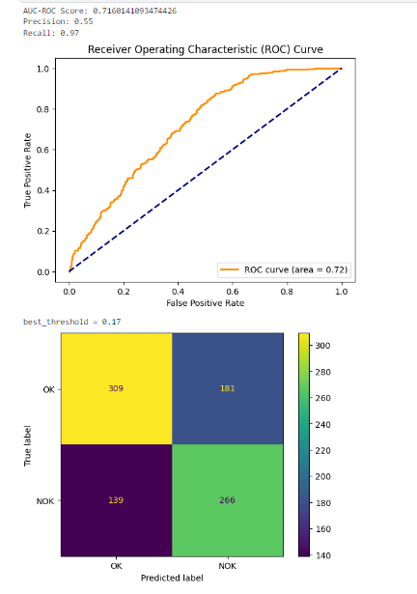
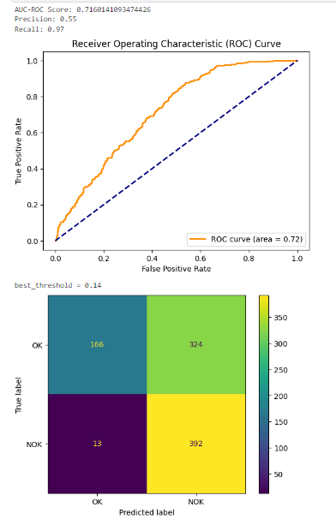
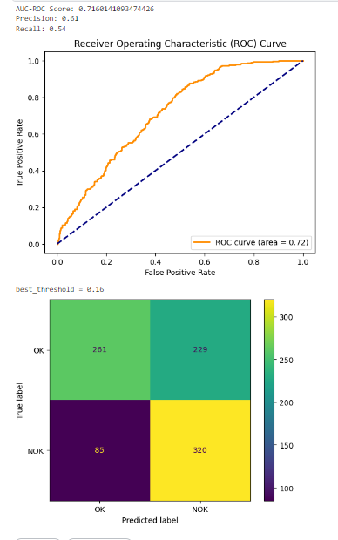
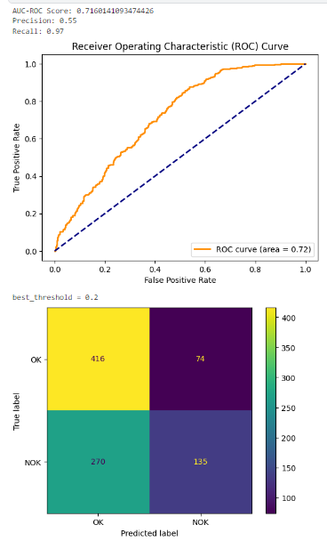
Testing results 2nd model

Slide 27
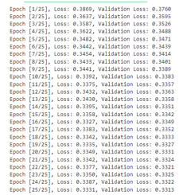
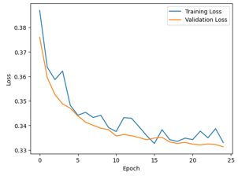
3rd Model
Convolution
k = 1 S = 1
BatchNorm - ReLU
1536x28x28→ 868x28x28
Convolution
k = 1 S = 1
BatchNorm - ReLU
868x28x28→ 400x28x28
Convolution
k = 1 S = 1
BatchNorm - ReLU
400x28x28→ 200x28x28
Convolution
k = 1 S = 1
200x28x28→ 100x28x28
Transposed Conv
BatchNorm- ReLU
k = 1 S = 1
100x28x28→ 200x28x28
Transposed Conv
BatchNorm- ReLU
k = 1 S = 1
200x28x28→ 400x28x28
Transposed Conv
BatchNorm- ReLU
k = 1 S = 1
400x28x28→ 868x28x28
TransposedConv
k = 1 S = 1
868x28x28→ 1536x28x28

Slide 28
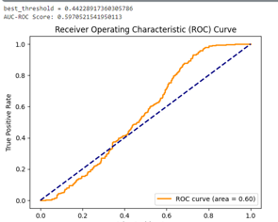
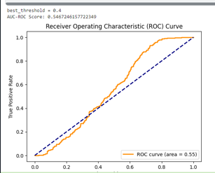
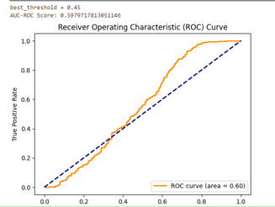
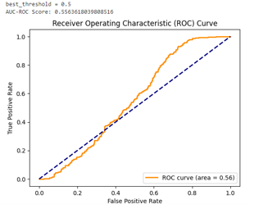
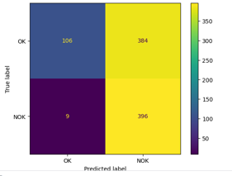
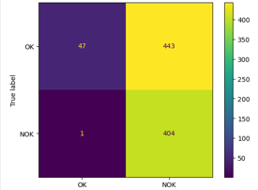
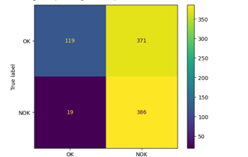
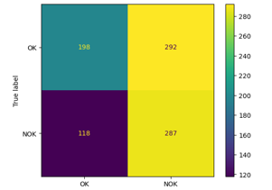
Testing results 3rd model

Slide 29
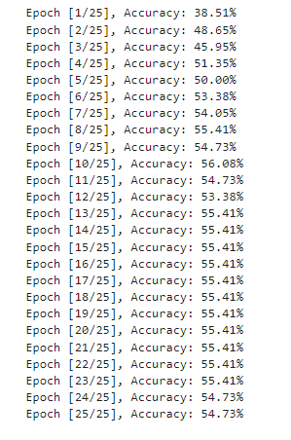
1st classifier
Convolution- ReLU
k = 3 P = 1
3x224x224 → 16x224x224
MaxPool
k = 2 S = 2
16x224x224→ 16x112x112
Convolution- ReLU
k = 3 P = 1
16x112x112 → 32x112x112
MaxPool
k = 2 S = 2
32x112x112 → 32x56x56
Convolution- ReLU
k = 3 P = 1
32x56x56 → 64x56x56
MaxPool
k = 2 S = 2
64x56x56→ 64x28x28
Linear - ReLU
64x28x28 → 128
Linear
128 → 4

Slide 30


Results 1st classifier

Slide 31

2nd classifier
Convolution- ReLU
k = 3 P = 1
3x224x224 → 16x224x224
MaxPool
k = 2 S = 2
16x224x224→ 16x112x112
Convolution- ReLU
k = 3 P = 1
16x112x112 → 32x112x112
MaxPool
k = 2 S = 2
32x112x112 → 32x56x56
Convolution- ReLU
k = 3 P = 1
32x56x56 → 64x56x56
MaxPool
k = 2 S = 2
64x56x56→ 64x28x28
Linear - ReLU
64x28x28 → 128
Dropout(0.5)
Linear
128 → 4

Slide 32


Results 2nd classifier

Slide 33

3nd classifier
Convolution- ReLU
k = 5 P = 1
3x224x224 → 16x222x222
MaxPool
k = 2 S = 2
16x222x222→ 16x111x111
Convolution- ReLU
k = 5 P = 1
16x111x111 → 32x109x109
MaxPool
k = 2 S = 2
32x109x109 → 32x54x54
Convolution- ReLU
k = 5 P = 1
32x54x54 → 64x54x52
MaxPool
k = 2 S = 2
64x52x52→ 64x26x26
Linear - ReLU
64x26x26 → 128
Dropout(0.5)
Linear
128 → 4

Slide 34


Results 3rd classifier

